Slide 1
Project Joseph Hoane: A Robotic Chess Player
By: SD02
Team members: Autrin Hakimi, Cal Hokanson-Fuchs, Junhyung Shim, Nhat Anh Bui, Thanh Mai
Client: Dr. Bowen Wang
Computer Science Department
Iowa State University
02/25/2025

Slide 2
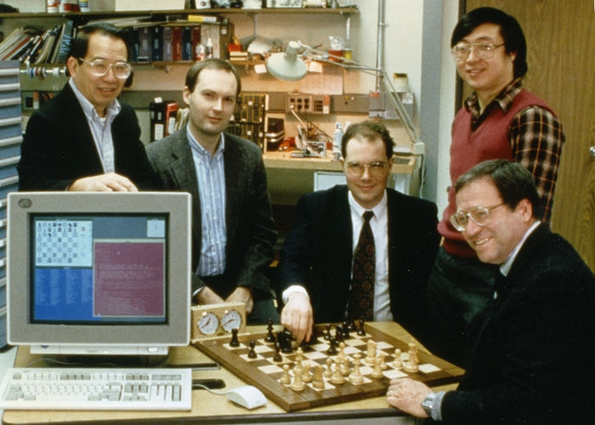
Problem Statement
Joseph Hoane is the man behind Deep Blue, a revolutionary AI that, in 1996, was the first ever to beat the reigning world chess champion.
AI has surpassed humans in chess, but robotic intelligence lacks physical embodiment.
Our goal is to enable a robotic
manipulator to play chess in the real world.

Slide 3

Solution Overview
What our system does in a high-level manner:
Uses a robotic arm to physically move chess pieces.
Uses a camera and AprilTags for board and piece recognition.
Uses a chess engine for move calculation.
Bridges perception and action using ROS (Robot Operating System).

Slide 4

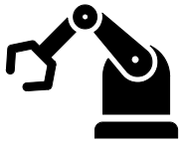


System Architecture
Camera captures board state
Image processing (AprilTags)
Chess engine
Robot arm moves the piece
Input
Output
Board mapping
FEN conversion
Processing

Slide 5
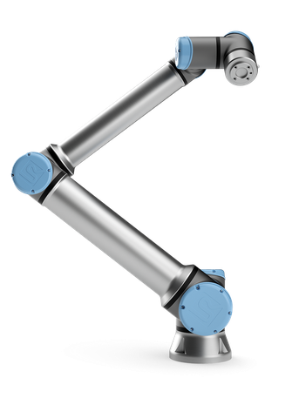



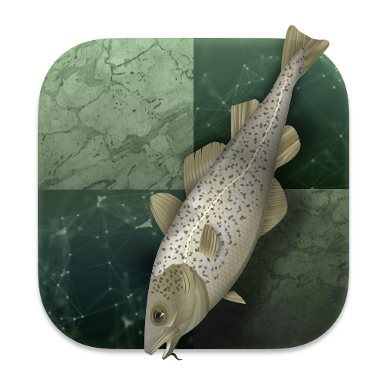
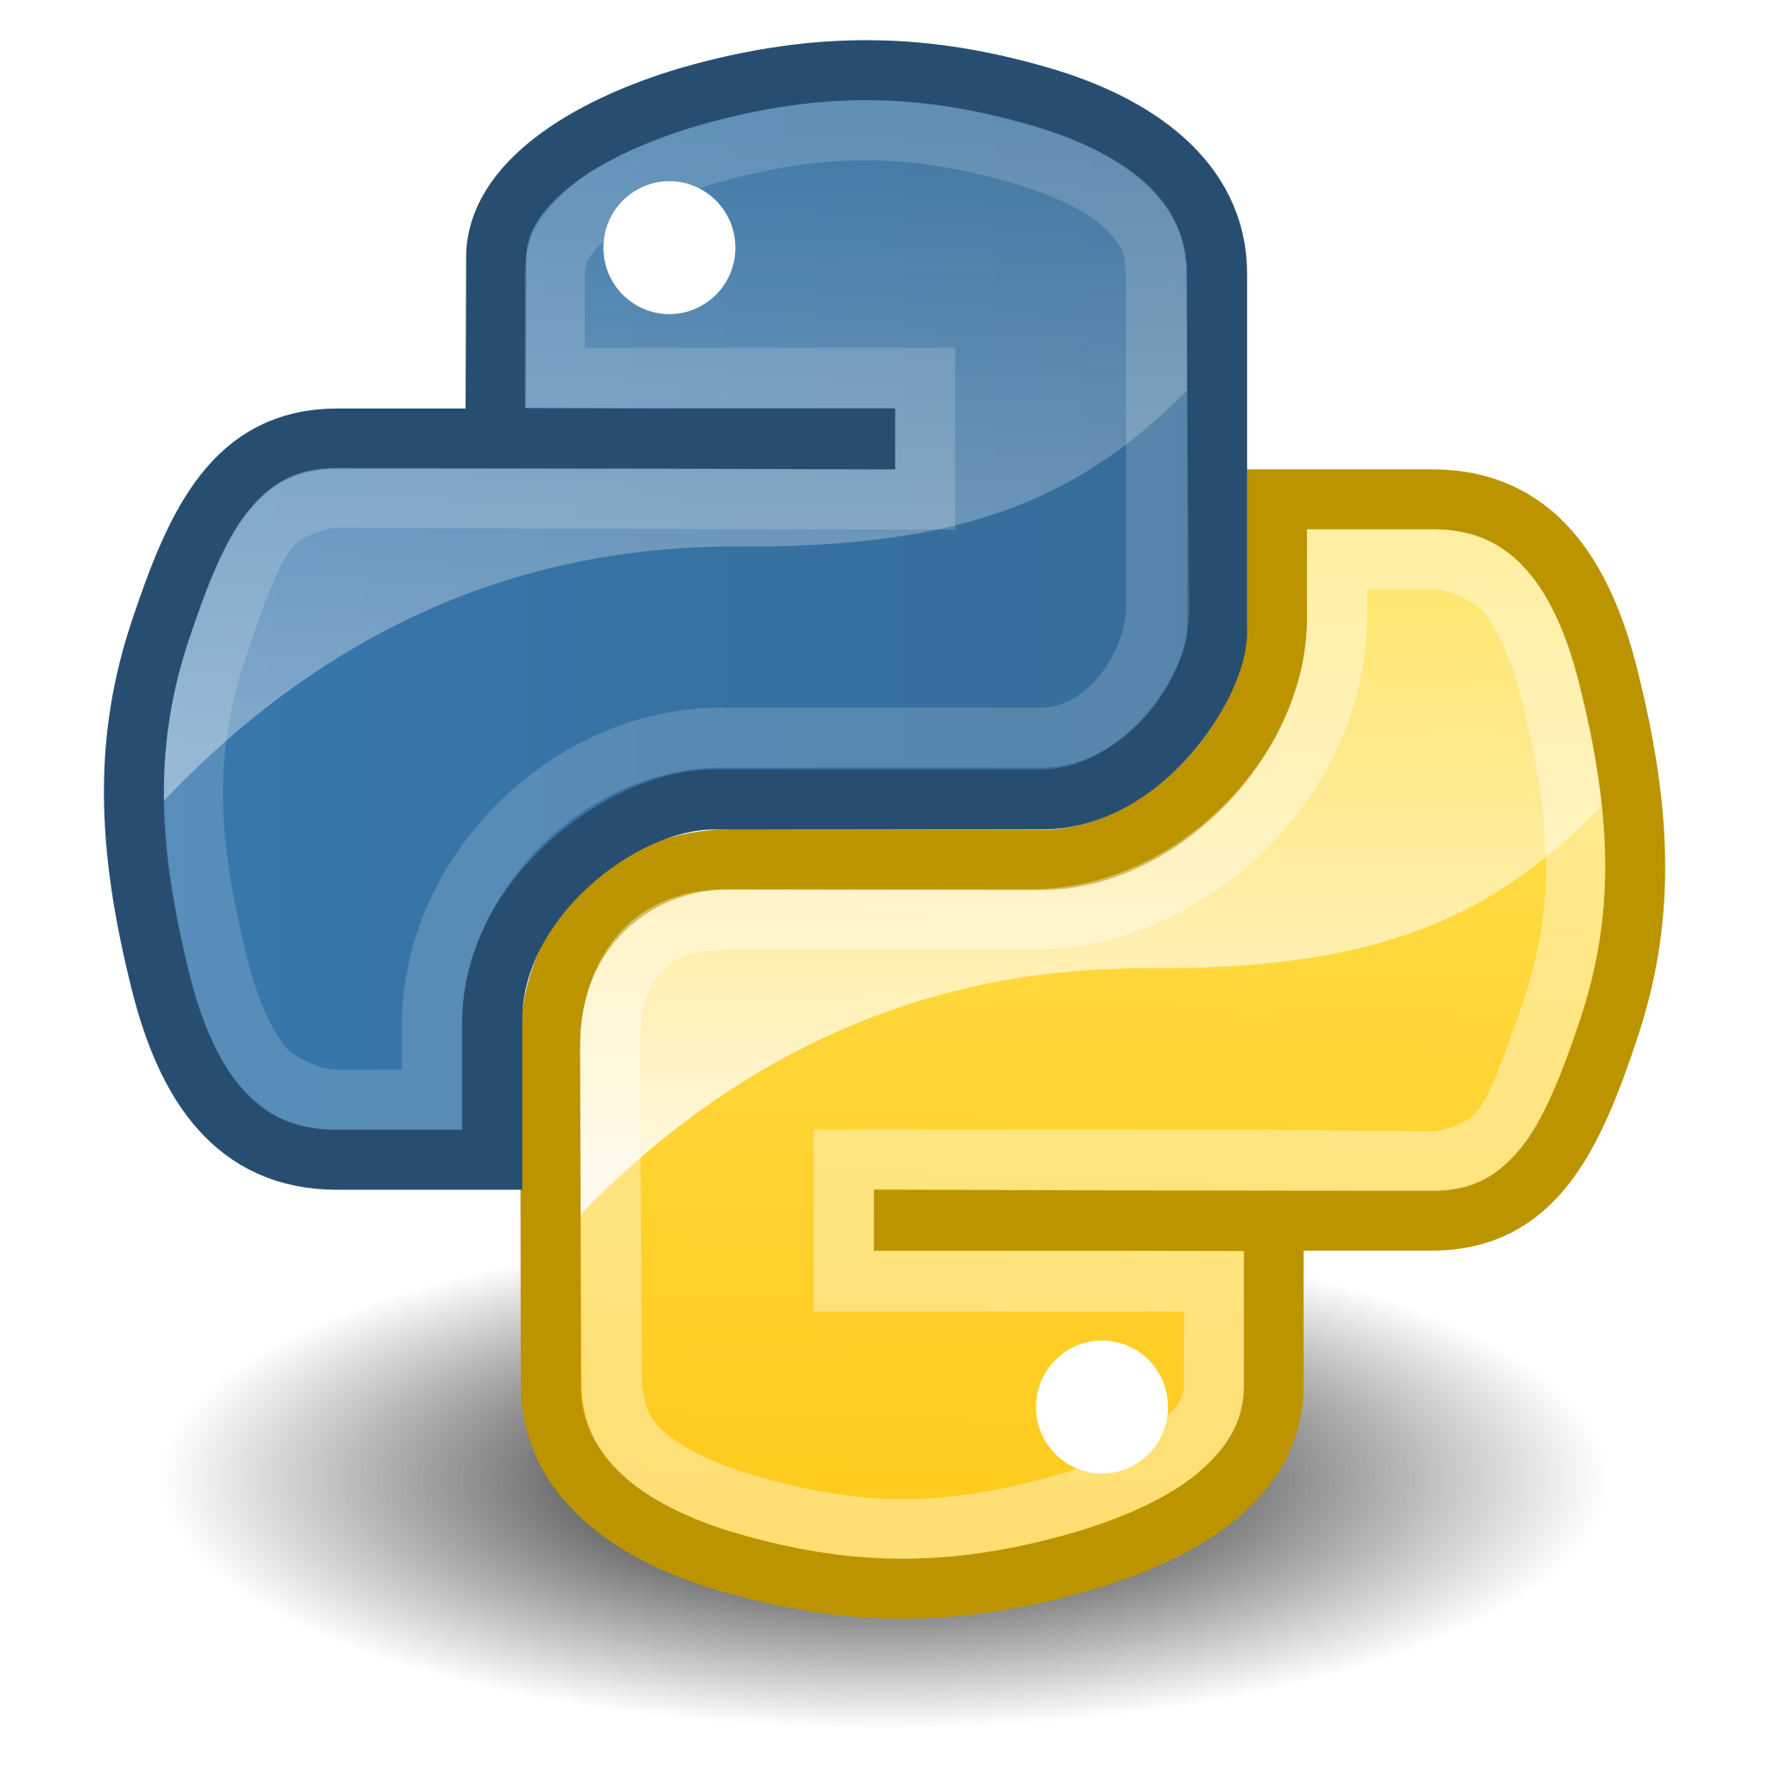
Hardware and Software Used
Hardware:
UR10e robotic arm + gripper
GoPro camera
3D-printed chess pieces
Software:
Ubuntu 20.04
ROS (Robot Operating System)
OpenCV (for image processing)
Stockfish (chess engine)
Python

Slide 6
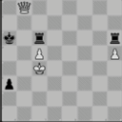
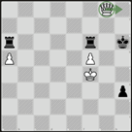
Chess Engine Integration
The camera captures the board.
The board state is converted to a FEN string.
Stockfish receives the FEN and calculates the best move.
The best move is converted into a physical move for the robotic arm.
Input: position fen 6Q1/8/r4r1k/P4P2/5K2/7p/8/8 w - - 0 60 Output: bestmove g8h8
go depth 5

Slide 7
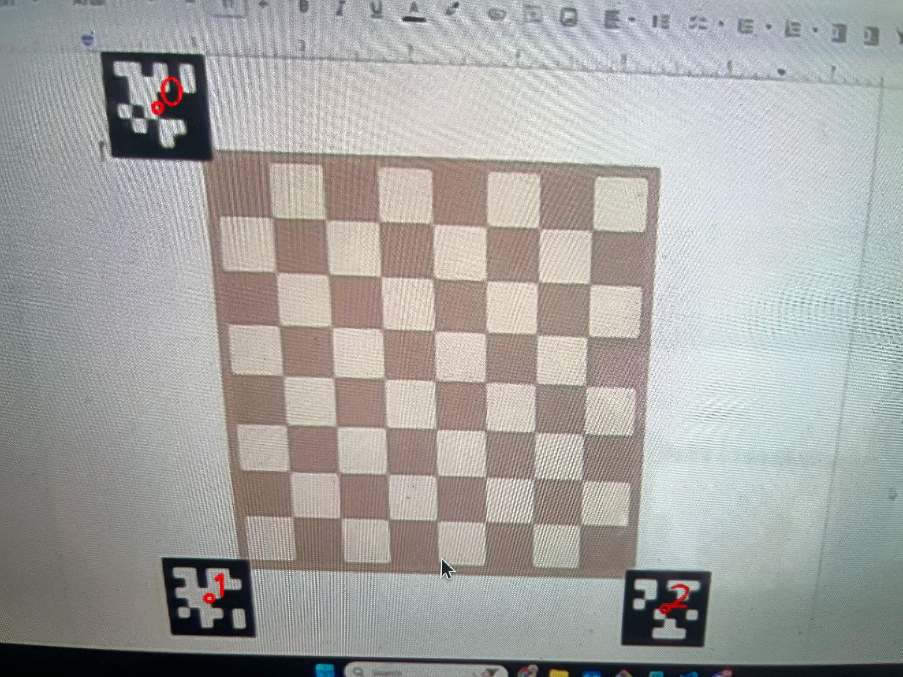
Board Detection Using AprilTags
Three AprilTags on the chessboard allow precise board mapping.
Camera detects and aligns the board coordinates.

Slide 8
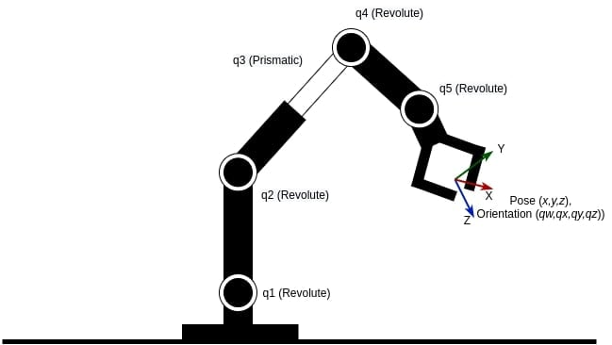
Robotic Arm Control
Uses MoveIt in ROS for motion planning.
Takes the best move from Stockfish and translates it into joint movements.
Uses inverse kinematics to calculate joint position given coordinates.
Handles precise pick-and-place actions.

Slide 9
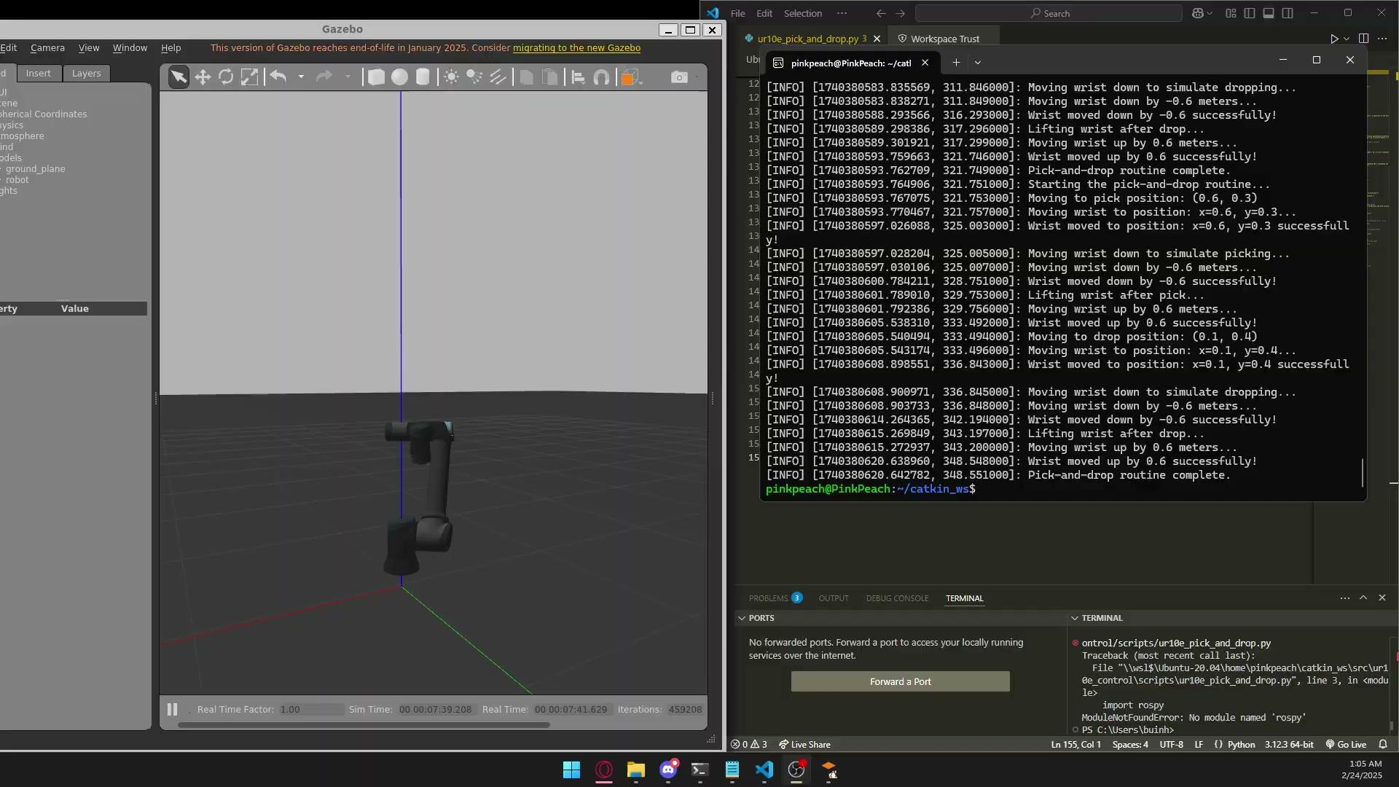
Simulated Pick-and-Place Motion in ROS

Slide 10
Current Progress
✅ Installed Ubuntu 20.04 and ROS
✅ Integrated chess engine (Stockfish)
✅ Implemented AprilTag-based board recognition
✅ Converted board state into FEN string
✅ Stockfish can now calculate legal moves
✅ Basic robotic arm movements implemented

Slide 11
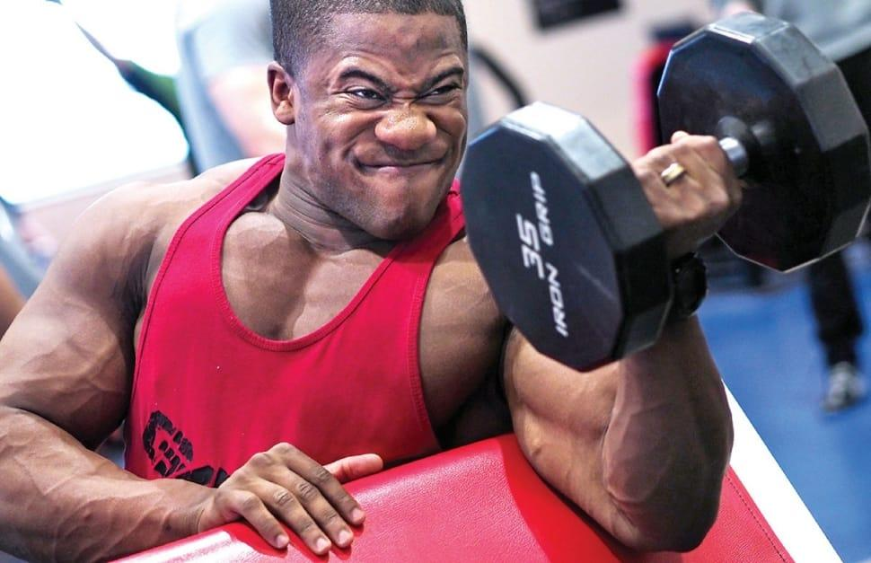
Challenges Faced
Board Alignment Problems → Using AprilTags for precise mapping.
Camera Calibration Issues → Adjusting contrast and gamma correction.

Slide 12
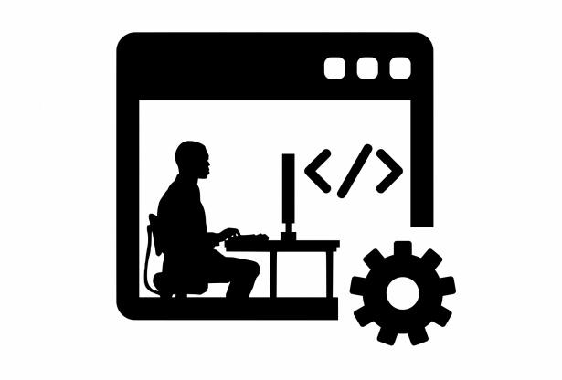
Next Steps & Timeline
What remains to be done?
Fine-tune robotic arm movement for accurate pick-and-place.
Improve chess piece detection using better image processing.
Add a user interface for interaction.
Perform extensive testing for real games.

